Slide 1
Game Design and Programming
Neil Gannon

Slide 2
User Interface Topics
Canvas
Layout
Controls
Events
Event Handling
Samples

Slide 3
Canvas

Slide 4

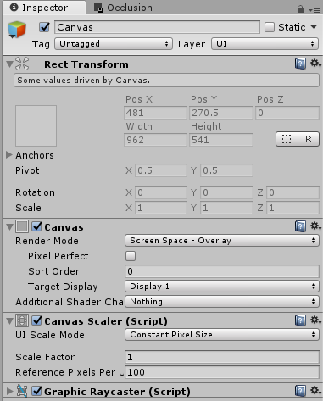
Canvas
All UI controls must be placed within a Canvas
A rectangular area where all UI controls must be placed
All UI controls are also represented as rectangles
If a canvas doesn't exist then one is automatically added
When the first canvas is created an Event System object is also created
This is required for user input to be detected
Allows controls in the canvas to react to input
A canvas comes with some default scripts

Slide 5
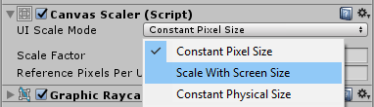
Canvas Scaling
An important default script is the Canvas Scalar
A game will support multiple screen resolutions
It is important that the UI scales with these resolutions
Must look the same on at all sizes
UI Scale Mode controls the type of scaling to be applied
By default the scaling mode will not scale the size of your UI to match the screen resolution
It will retain the original size you have set

Slide 6
Canvas Scaling
Property: | Function:
UI Scale Mode | Determines how UI elements in the Canvas are scaled.
Constant Pixel Size | Makes UI elements retain the same size in pixels regardless of screen size.
Scale With Screen Size | Makes UI elements bigger the bigger the screen is.
Constant Physical Size | Makes UI elements retain the same physical size regardless of screen size and resolution.

Slide 7
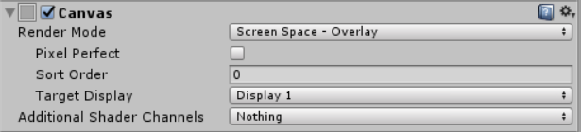
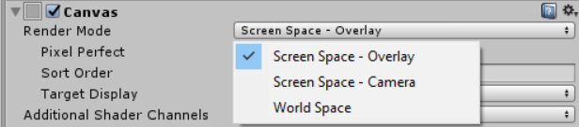
Canvas Render Mode
We can render the canvas in different ways depending on the game
Screen Space Overlay
Ensure the UI is always drawn on top of everything else in the game
Default mode for the Canvas
World Space
Treats your canvas as a 3D object that can placed in the scene like any other object

Slide 8
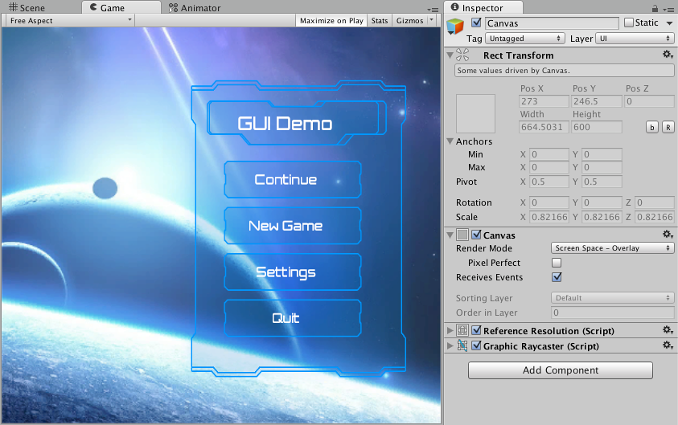
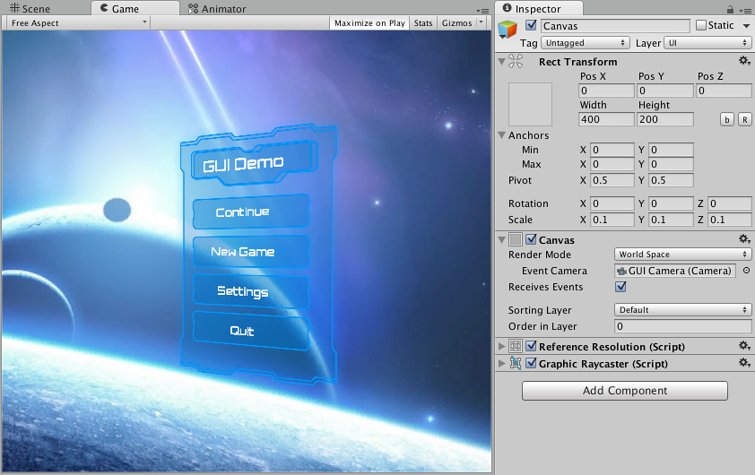
Canvas Render Mode
Screen Space
World Space

Slide 9
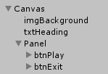
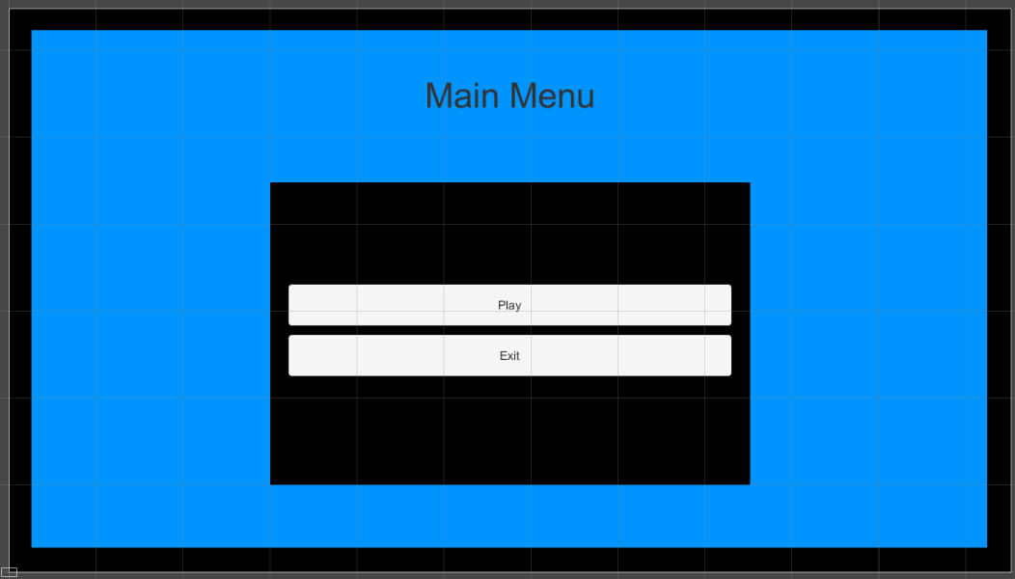

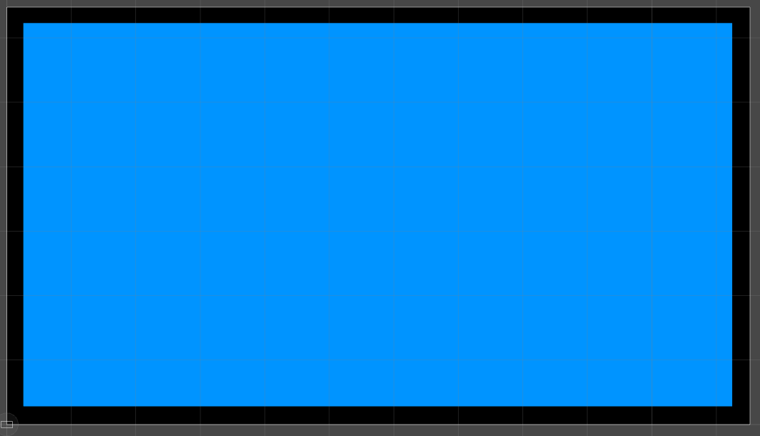
Draw Order
Previously we have used Order in Layer to control the depth of sprites
Negative numbers are behind
Positive numbers are in front
The UI system does not use the same logic
The order in in the scene hierarchy determines where the are drawn
Note the position of the Image control in the two samples on the right

Slide 10
Layout

Slide 11
Layout Overview
All UI controls are represented as rectangles in Unity
Like with sprites we are able to modify the rectangle
Width
Height
Rotation
Two key aspects of these rectangles are how the behave when
The size is modified
When the resolution changes and how they fill the new size of the canvas

Slide 12
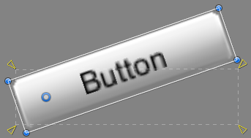
Pivots
Pivots set the origin for an object
Also exist on sprites
By default the pivot is set the be the center of the object
Width /2 and Height /2
By changing the pivot you are changing how the control behaves when
Rotated
Translated
When the pivot has been changed all transformations are applied around this new pivot point

Slide 13
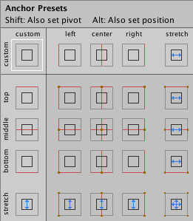
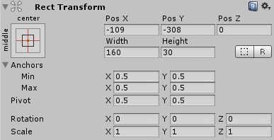
Anchors
Anchors are one of the most important parts of laying out a UI
Anchors represent 4 points from which your controls are positioned relative to
Unity provides a range of anchors to choose from
Which one you choose depends on where on the screen you want your controls to positioned
We will see these over the semester in range of samples available on Moodle
When an anchor is chosen we can choose
Position of the control relative to the anchor
Size of the control

Slide 14
Controls

Slide 15
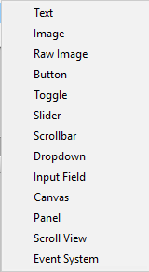
Controls
Unity comes with a selection of controls
Possible to create additional custom ones
Initially we will cover the core ones
Image
Text
Button
Slider
Panel
Remaining controls are more complex to use and will feature in standalone samples later

Slide 16
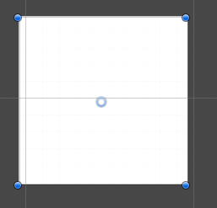
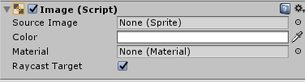
Image
Near identical to sprites
Can use a sprite image as a source
Color can be changed via the color picker

Slide 17
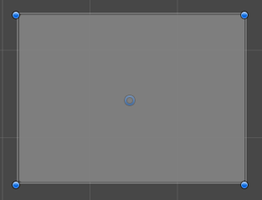
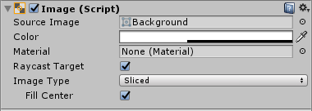
Panel
A container for other controls to placed within
Similar in nature to a canvas
Allows us to group related controls together
Controls within will be position relative the extents of the panel
Uses an image for it’s background

Slide 18

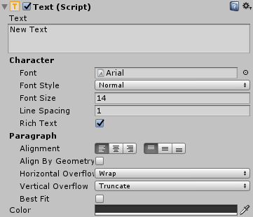
Text
Renders text within a rectangular area
Text can be entered using
The inspector
Through a C# script
Core properties
Size
Alignment
Color
Custom fonts can be added to your project like any other asset

Slide 19
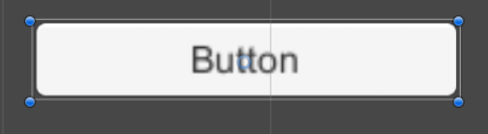

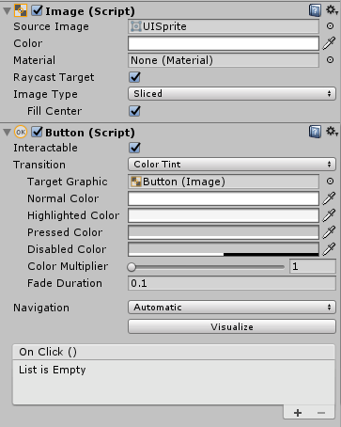
Button
A button consists of two controls
Image
Text
Buttons have states and change the color tint of the image based don these
Normal
Highlighted (Mouse Over)
Pressed (Clicked)
Disabled
Features an Event called OnClick
Core use of the button is this event

Slide 20


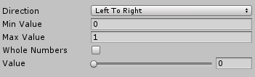
Slider
A slider allows us to pick an numerical value using a sliding bar
Either horizontal or vertical
We can pick the min and max range of the values the slider can choose between
By default these values are decimals (floats)
Can be changed to only use whole numbers (ints)
The value property stores the currently selected value
Can be changed by dragging the handle
Or using code

Slide 21
Events

Slide 22

Events
A core concept of UI controls is the idea of an Event
An event is raised when the state of a control changes
We must provide an event handler in order to perform an action in code
These handers are written as functions and we can assign these functions to the event
This code is only executed when that event is fired
The type of events that are available depending on the control in use
The button features the OnClick event for when the user performs a full Mouse Down and Up action

Slide 23
Event Handling

Slide 24
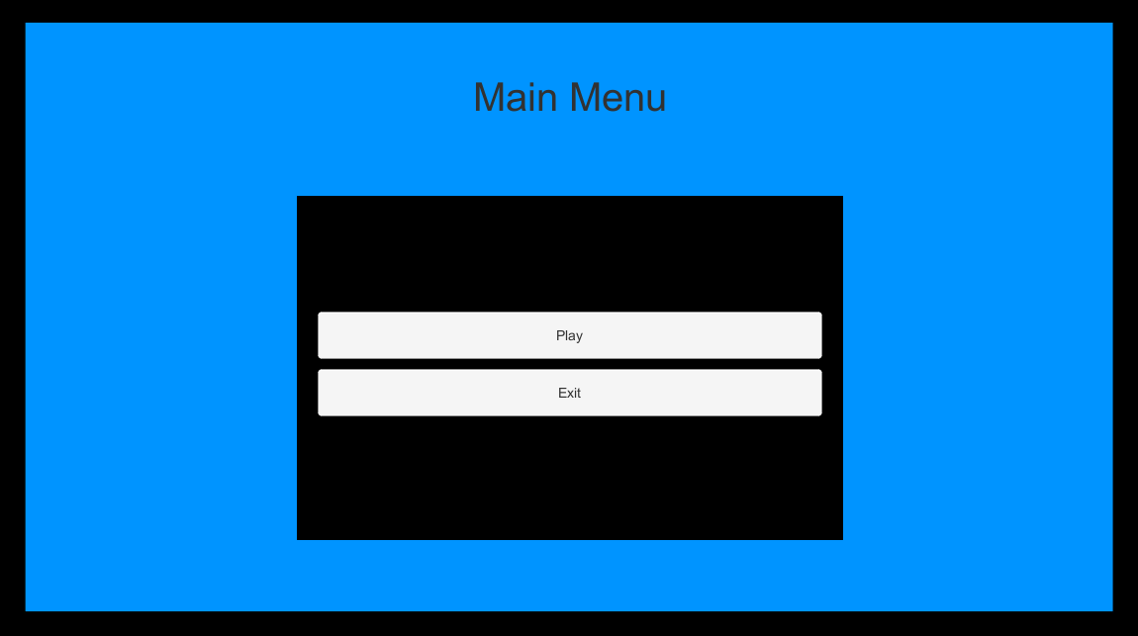
Main Menu Functions
Our sample main menu features two buttons
One for loading the scene with our first level
The other for exiting the application
We need to create script that will proved the handlers (methods) for the OnClick events of these buttons

Slide 25
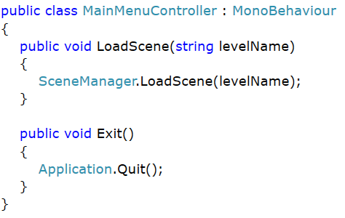
MainMenuController (Script)
MainMenuController will be attached to canvas control in the main menu scene
It provides two functions that will be our event handlers for the OnClick events
LoadScene will take the name of the scene we want to load
Exit will simply close the game down
Note both functions must be public in order to be visible outside the script

Slide 26

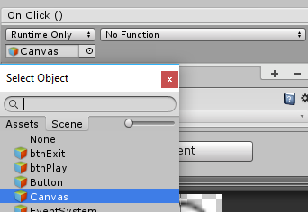
In Unity Inspector
When a button is selected in Unity the Event box will show in the inspector
Clicking the + button will allows us to setup the handler for the OnClick event
In order to access the functions we want
Need to select the object in the scene that has our MainMenuController script

Slide 27
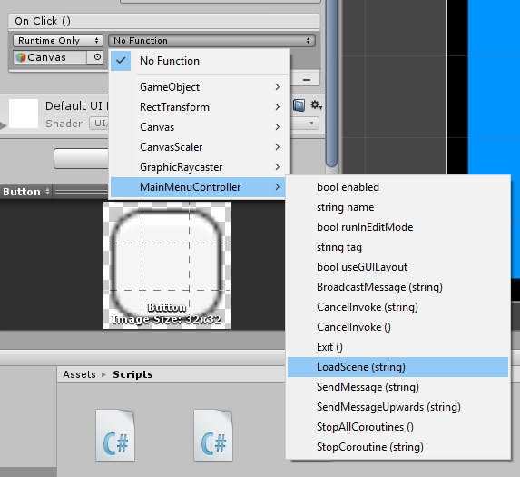


In Unity Inspector
When the object with the script has been selected
We must choose the exact script that holds our functions
Select the desired function from the provided list
If the method has input parameters then a text box will appear
Enter the desired value
Where no input parameters are required by the function then no box appears
Method with parameters
Method without parameters

Slide 28
Main Menu Sample

Slide 29
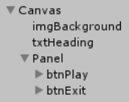
Main Menu Overview

Slide 30
Game HUD with Health Bar Sample

Slide 31
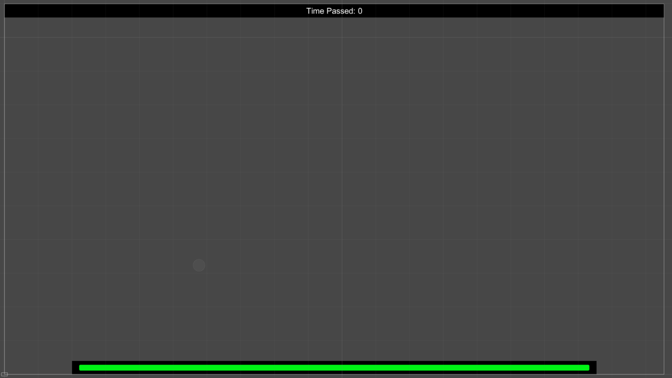
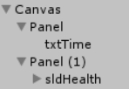
Main Menu Overview

Slide 32
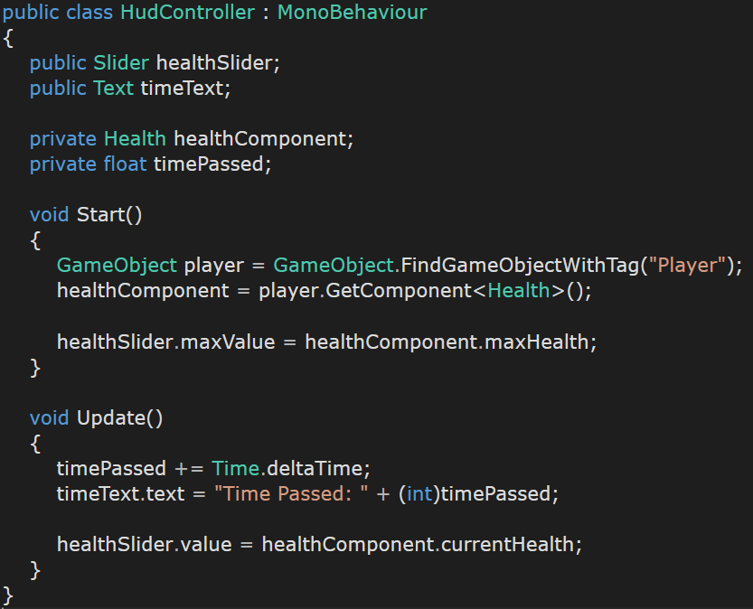
Hud Controller Script
The scene contains a player with a health script
Health script has max health and current health variables
We set the max value of the slider to be the max health
We update the value variable of the slider to be our current health

